Slide 1

MOOCs, Past, Present, and Future
Dr. Charles Severance
www.dr-chuck.com
Notes:
Past: Sunrise / TV / Syncomat / CB2K / Sakai / LTI / OER
Present: Crème rises / Competition / Looked @ Python MSUI / BSI / Automation / Scale / Specialization further scale
I am better online than in class – student motivation / weariness

Slide 2
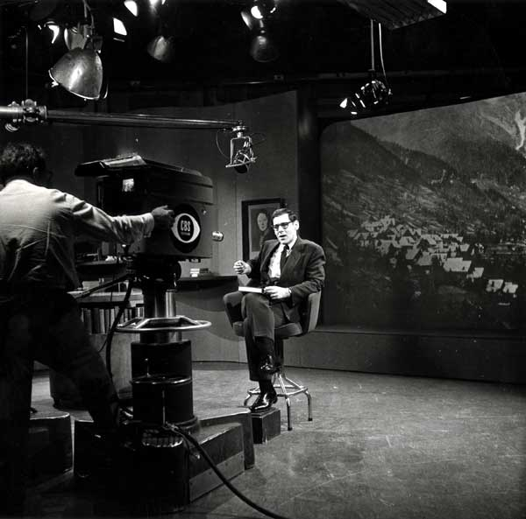
Sunrise Semester
New York University
CBS – 6:00AM
1957-1982
120K students
Precursor to PBS
https://en.wikipedia.org/wiki/Sunrise_Semester

Slide 3

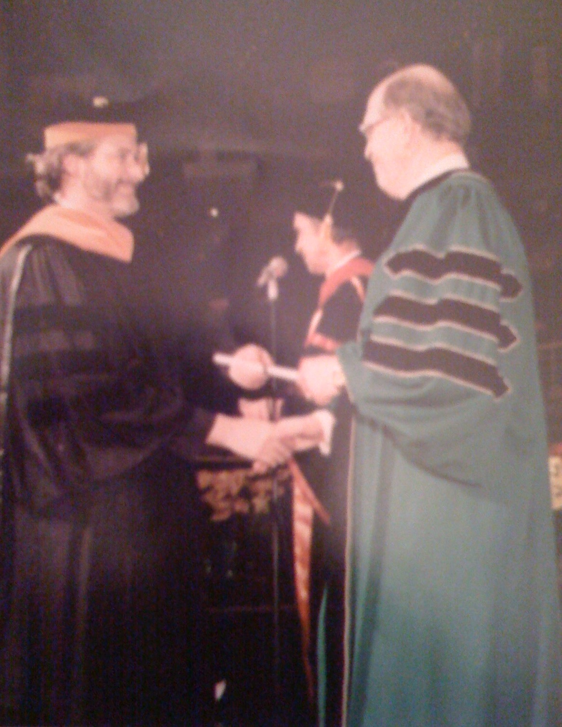
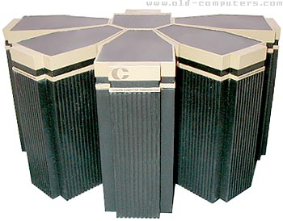
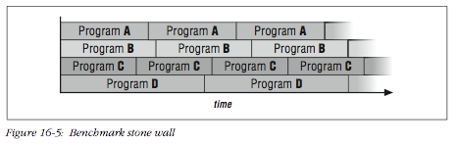
1996

Slide 4
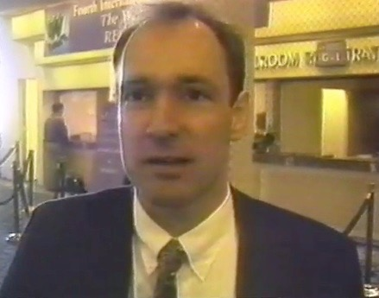
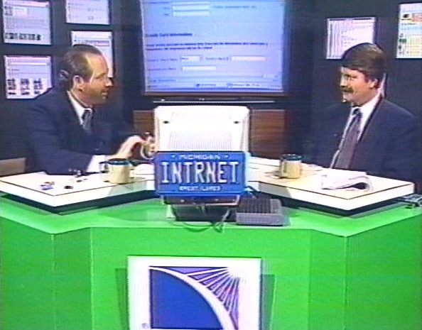
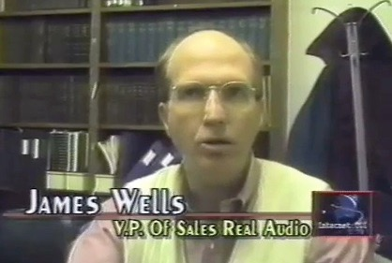
1996

Slide 5
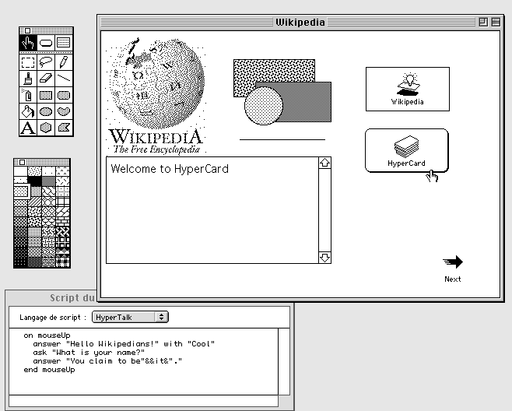
1996

Slide 6
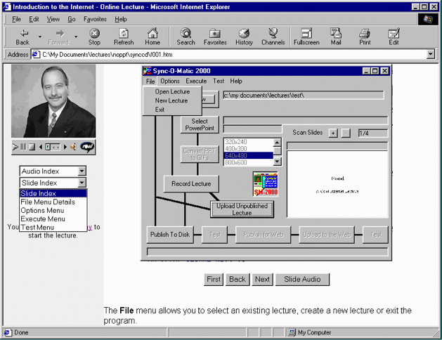
1996

Slide 7
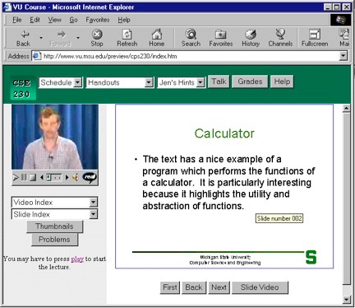
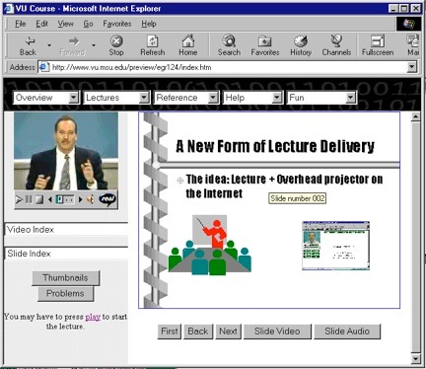
Sync-O-Matic
www.syncomat.com
1997

Slide 8
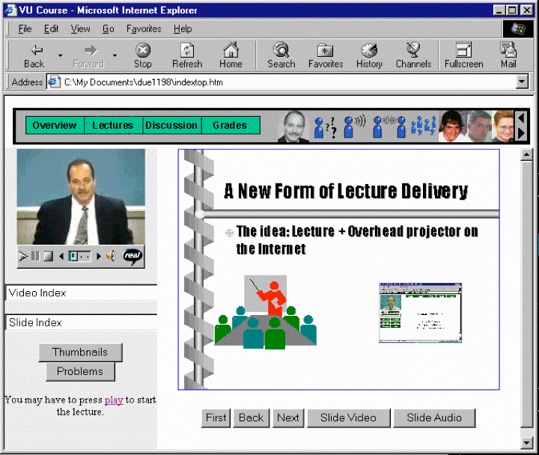
Title: Using Asynchronous, Web-based, Video to Humanize Distance Education
1998

Slide 9
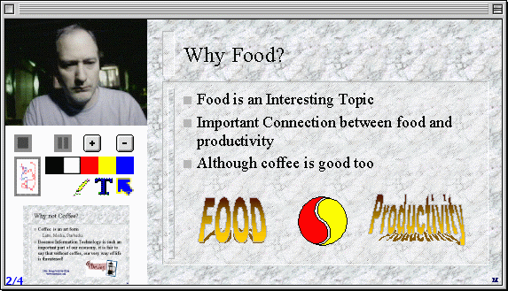
2000
http://www-personal.umich.edu/~csev/csev/projects/cb2k/index.htm

Slide 10

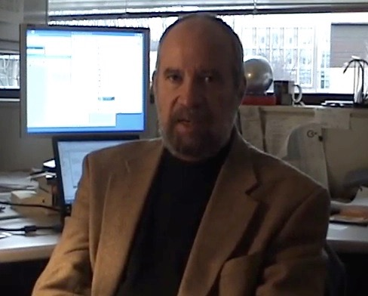
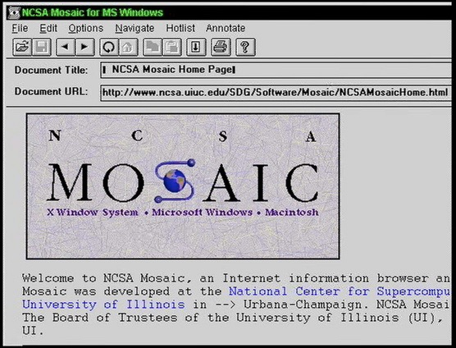
2003

Slide 11

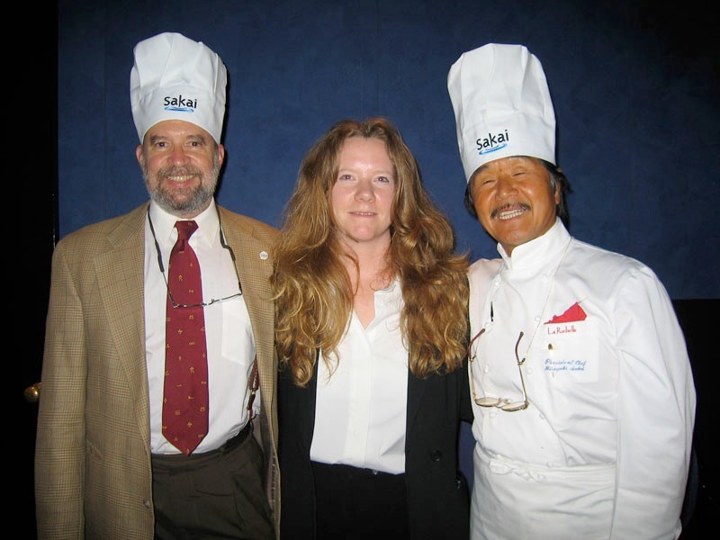
2004

Slide 12
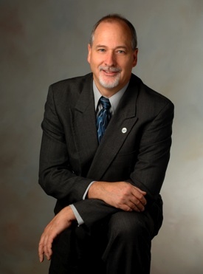

2004
2007

Slide 13
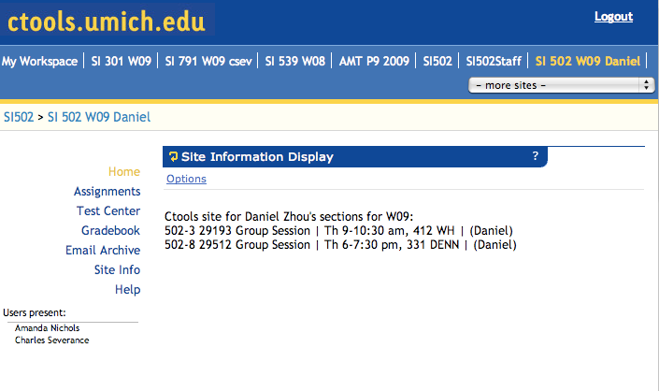

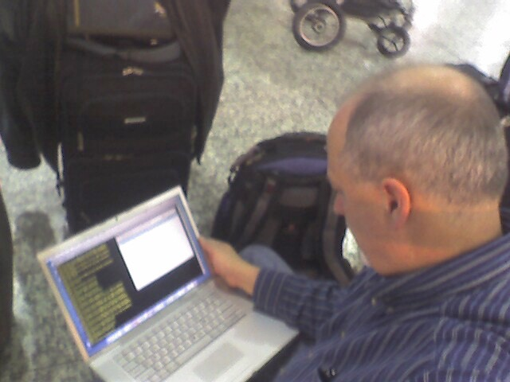
2007

Slide 14
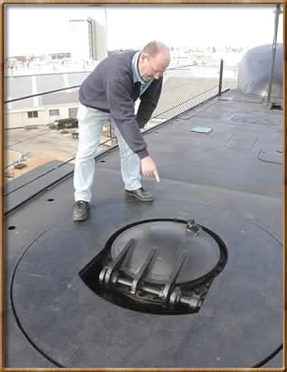
2008

Slide 15
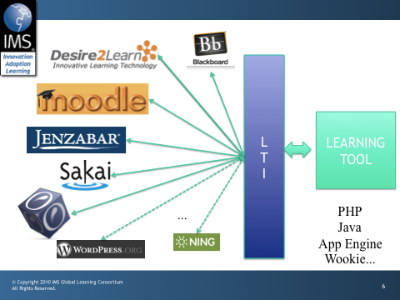

Slide 16
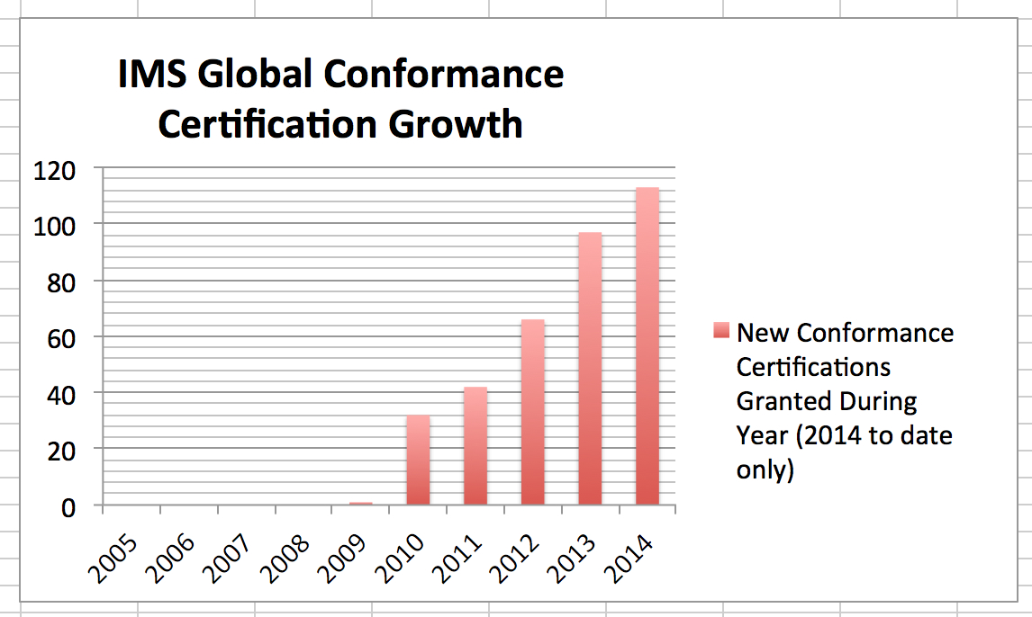

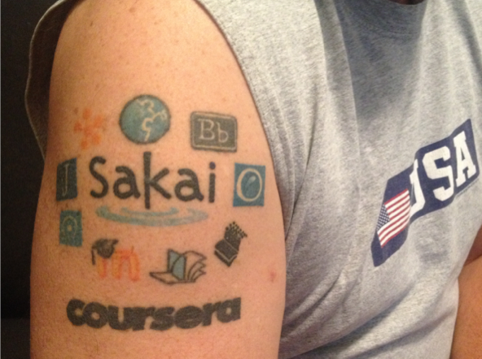


Slide 17

































2011

Slide 18

2012

Slide 19
Internet: TCI
Nuthin’ But Net

Slide 21
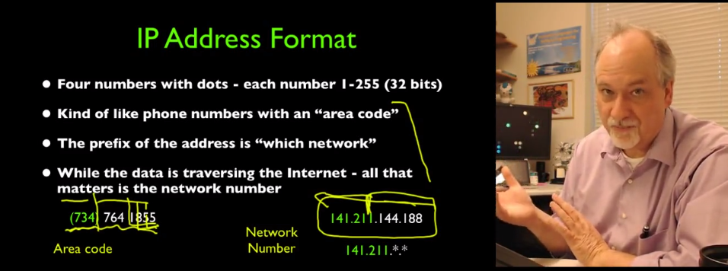
2012

Slide 22
N=4701
http://www.dr-chuck.com/coursera/insidetheinternet/2012-001/maps/where.html

Slide 23
Megan (UK)
Karen (NC)
Mazen (Egypt)
Sue (CA)
Susan (PA)
Mauro (Italy)

Slide 24
New York, Los Angeles, Ann Arbor, Chicago, Washington DC, Memphis, Seattle, Seoul, Barcelona, London, Mexico City, Amsterdam, Manila Melbourne, Perth...
http://office-hours.dr-chuck.com
Notes:
Since I have a very active travel schedule, I decided to hold office hours in the major cities I have visited. I have held office hours in over 40cities and in each location somewhere between two and 15 students show up.

Slide 25
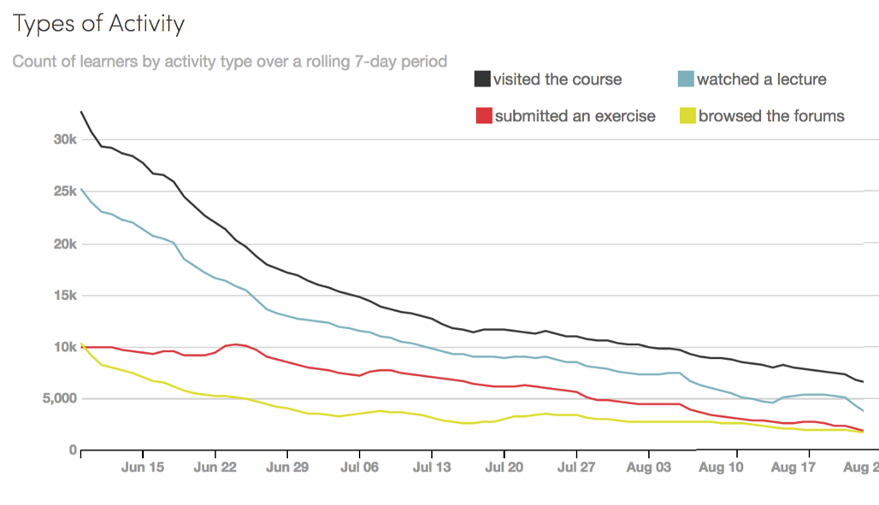

Slide 27
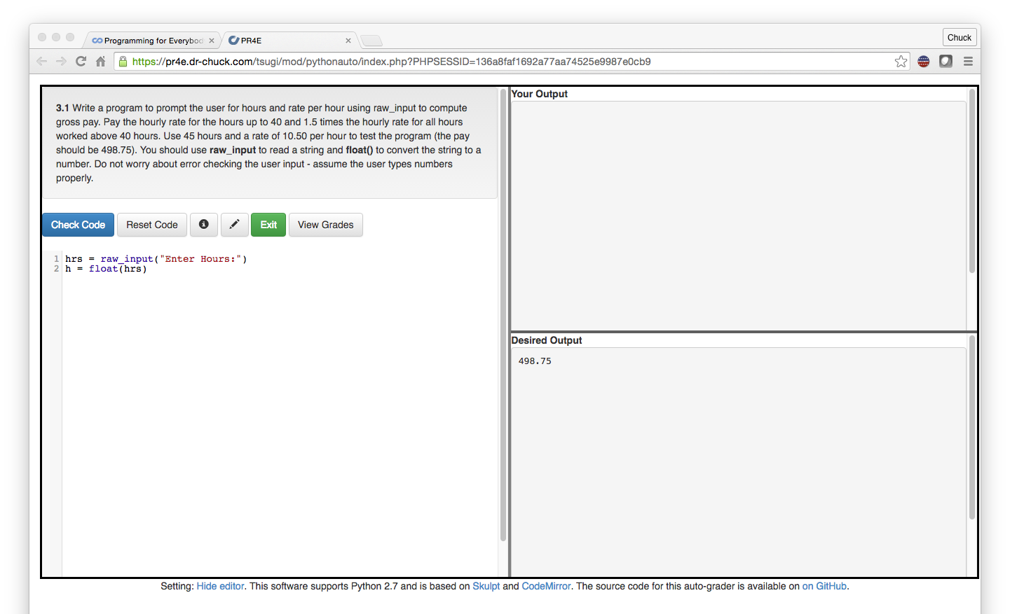
IMS Learning Tools Interoperabilirty
www.tsugi.org

Slide 28

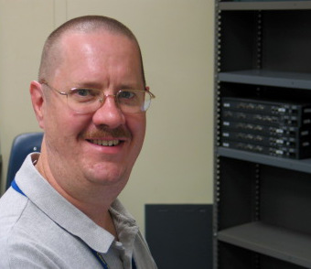
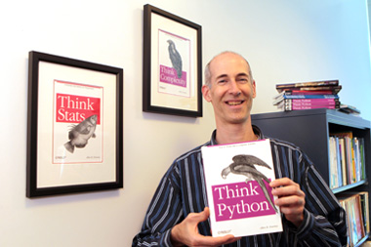
A Free Book
www.pythonlearn.com
Notes:
Average about 400/month

Slide 29


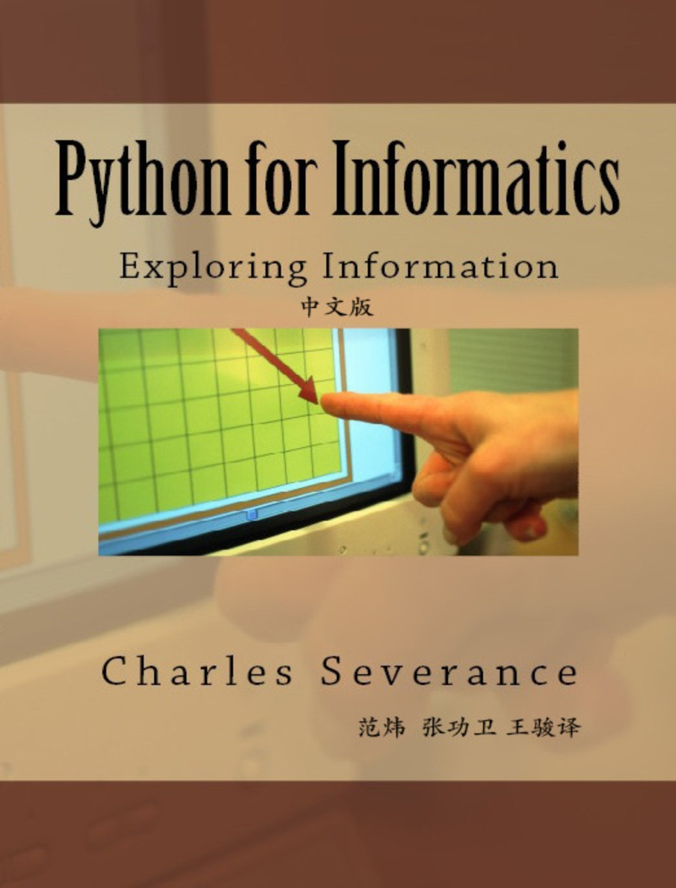



Open Educational Resources

Slide 30
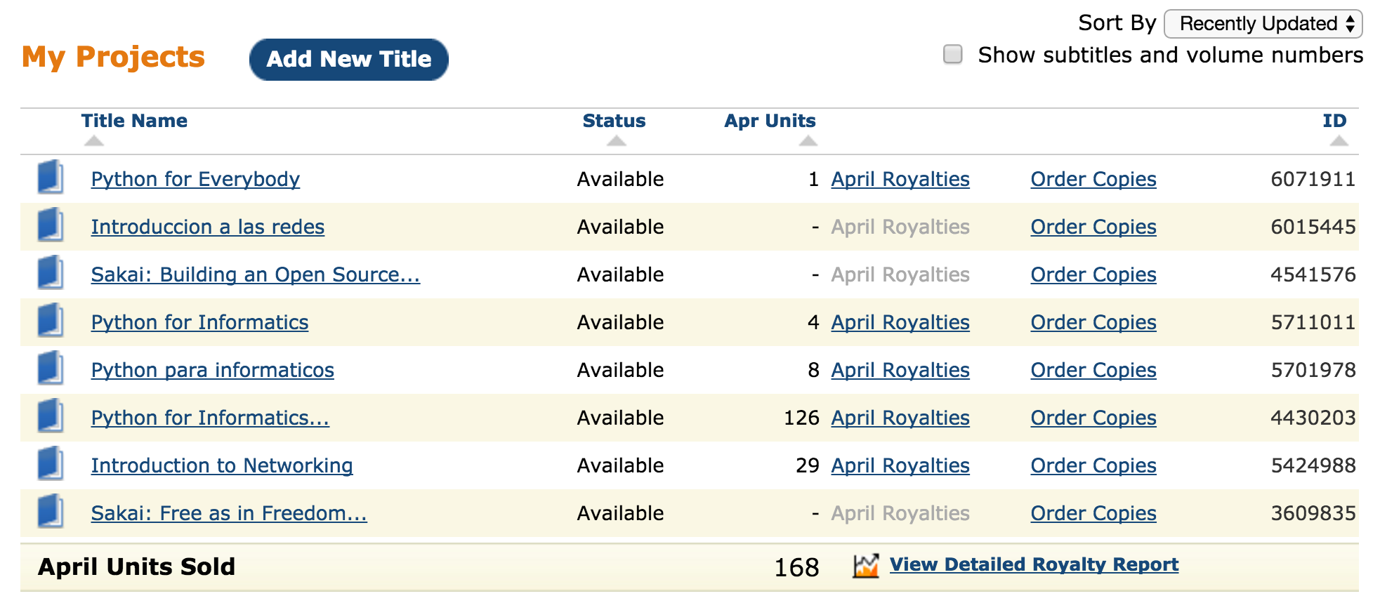
Amazon CreateSpace

Slide 31

https://youtu.be/4hIwl_8hmq8

Slide 32
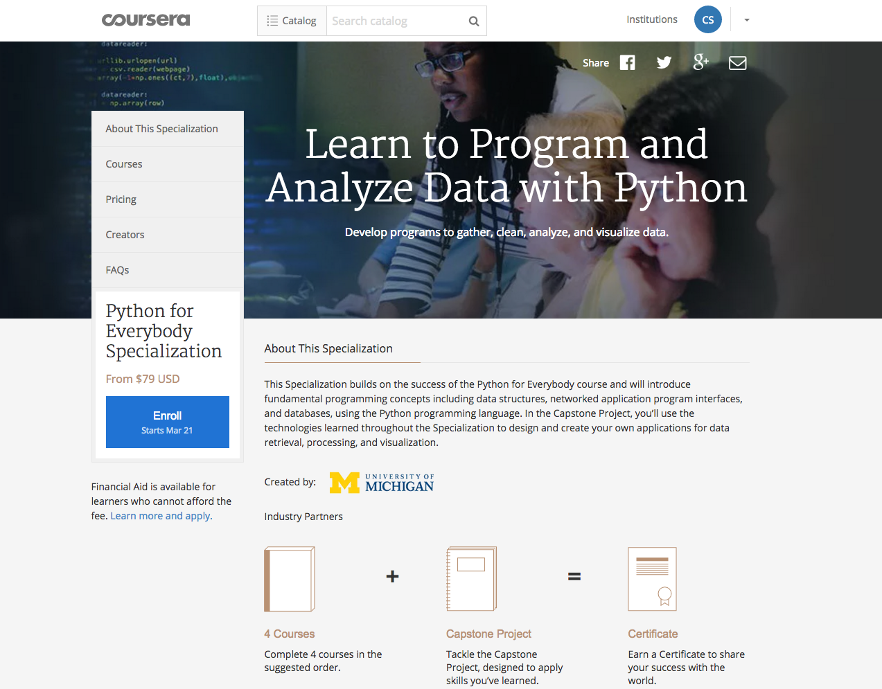
2015-

Slide 33
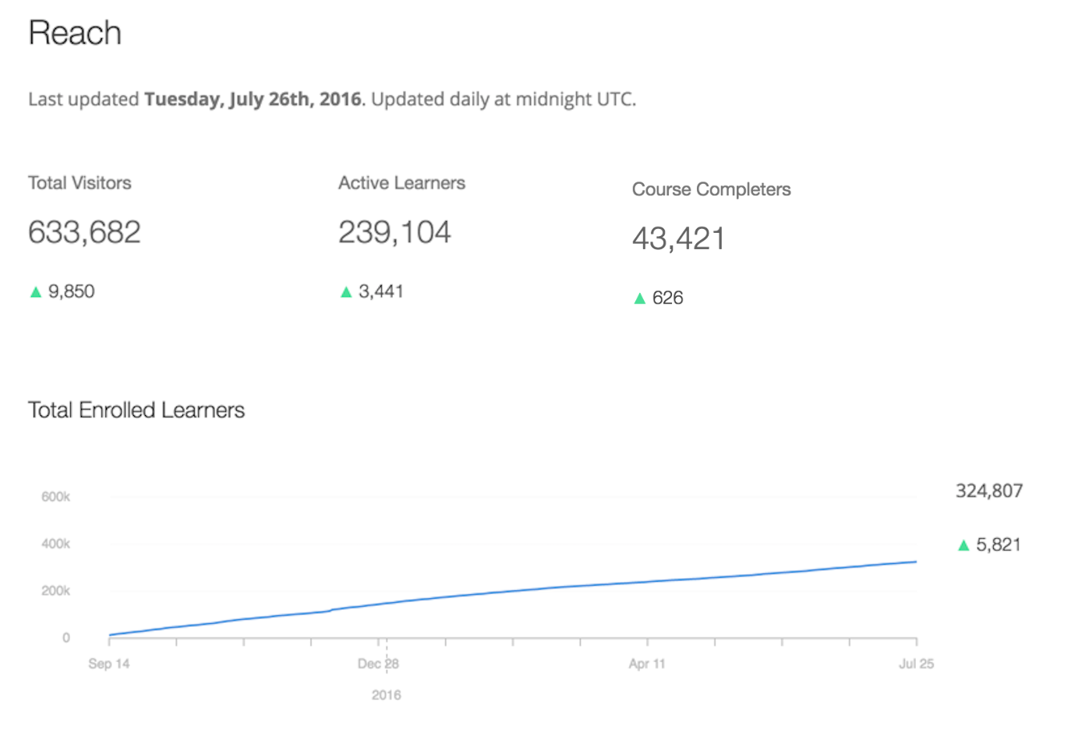
Programming for Everybody (Getting Started with Python)
A 5-week source with a new cohort starting every three weeks.

Slide 34
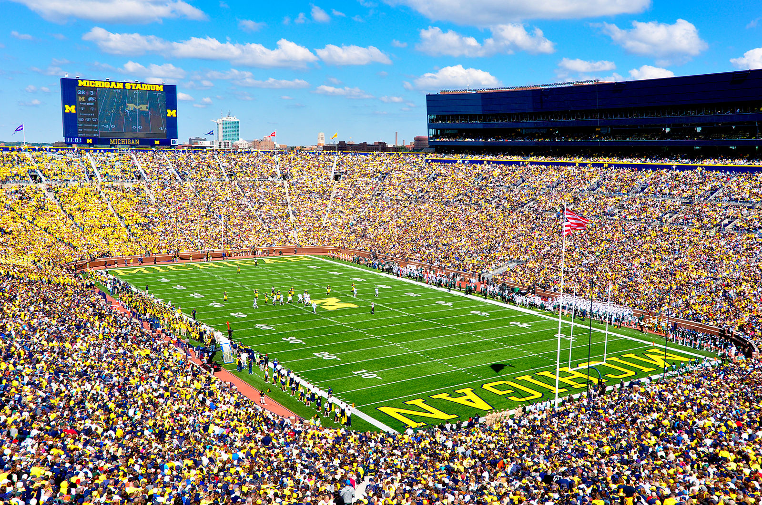
https://commons.wikimedia.org/wiki/File:Michigan_Stadium_Sept_17,2011.jpg

Slide 35
Learn to Program and Analyze Data with Python
Four 5-week courses plus a capstone with a new cohort starting every three weeks.
1
2
3
4
5
1
2
3
4
5
1
2
3
4
5
1
2
3
4
5
1
2
3
4
5
Capstone

Slide 36
Looking Ahead
Content + Personality + Engagement + Scale + Distribution

Slide 38
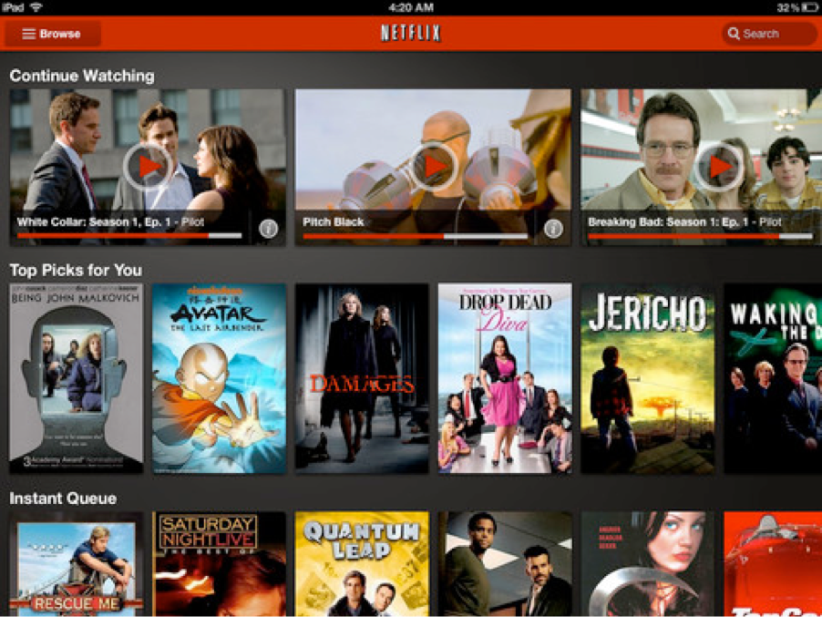
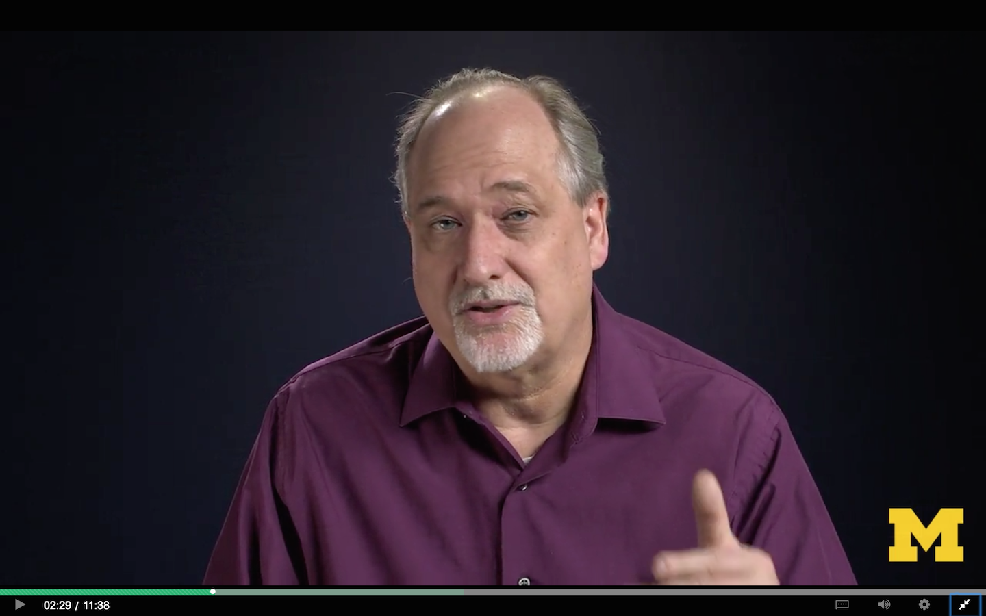

Slide 39
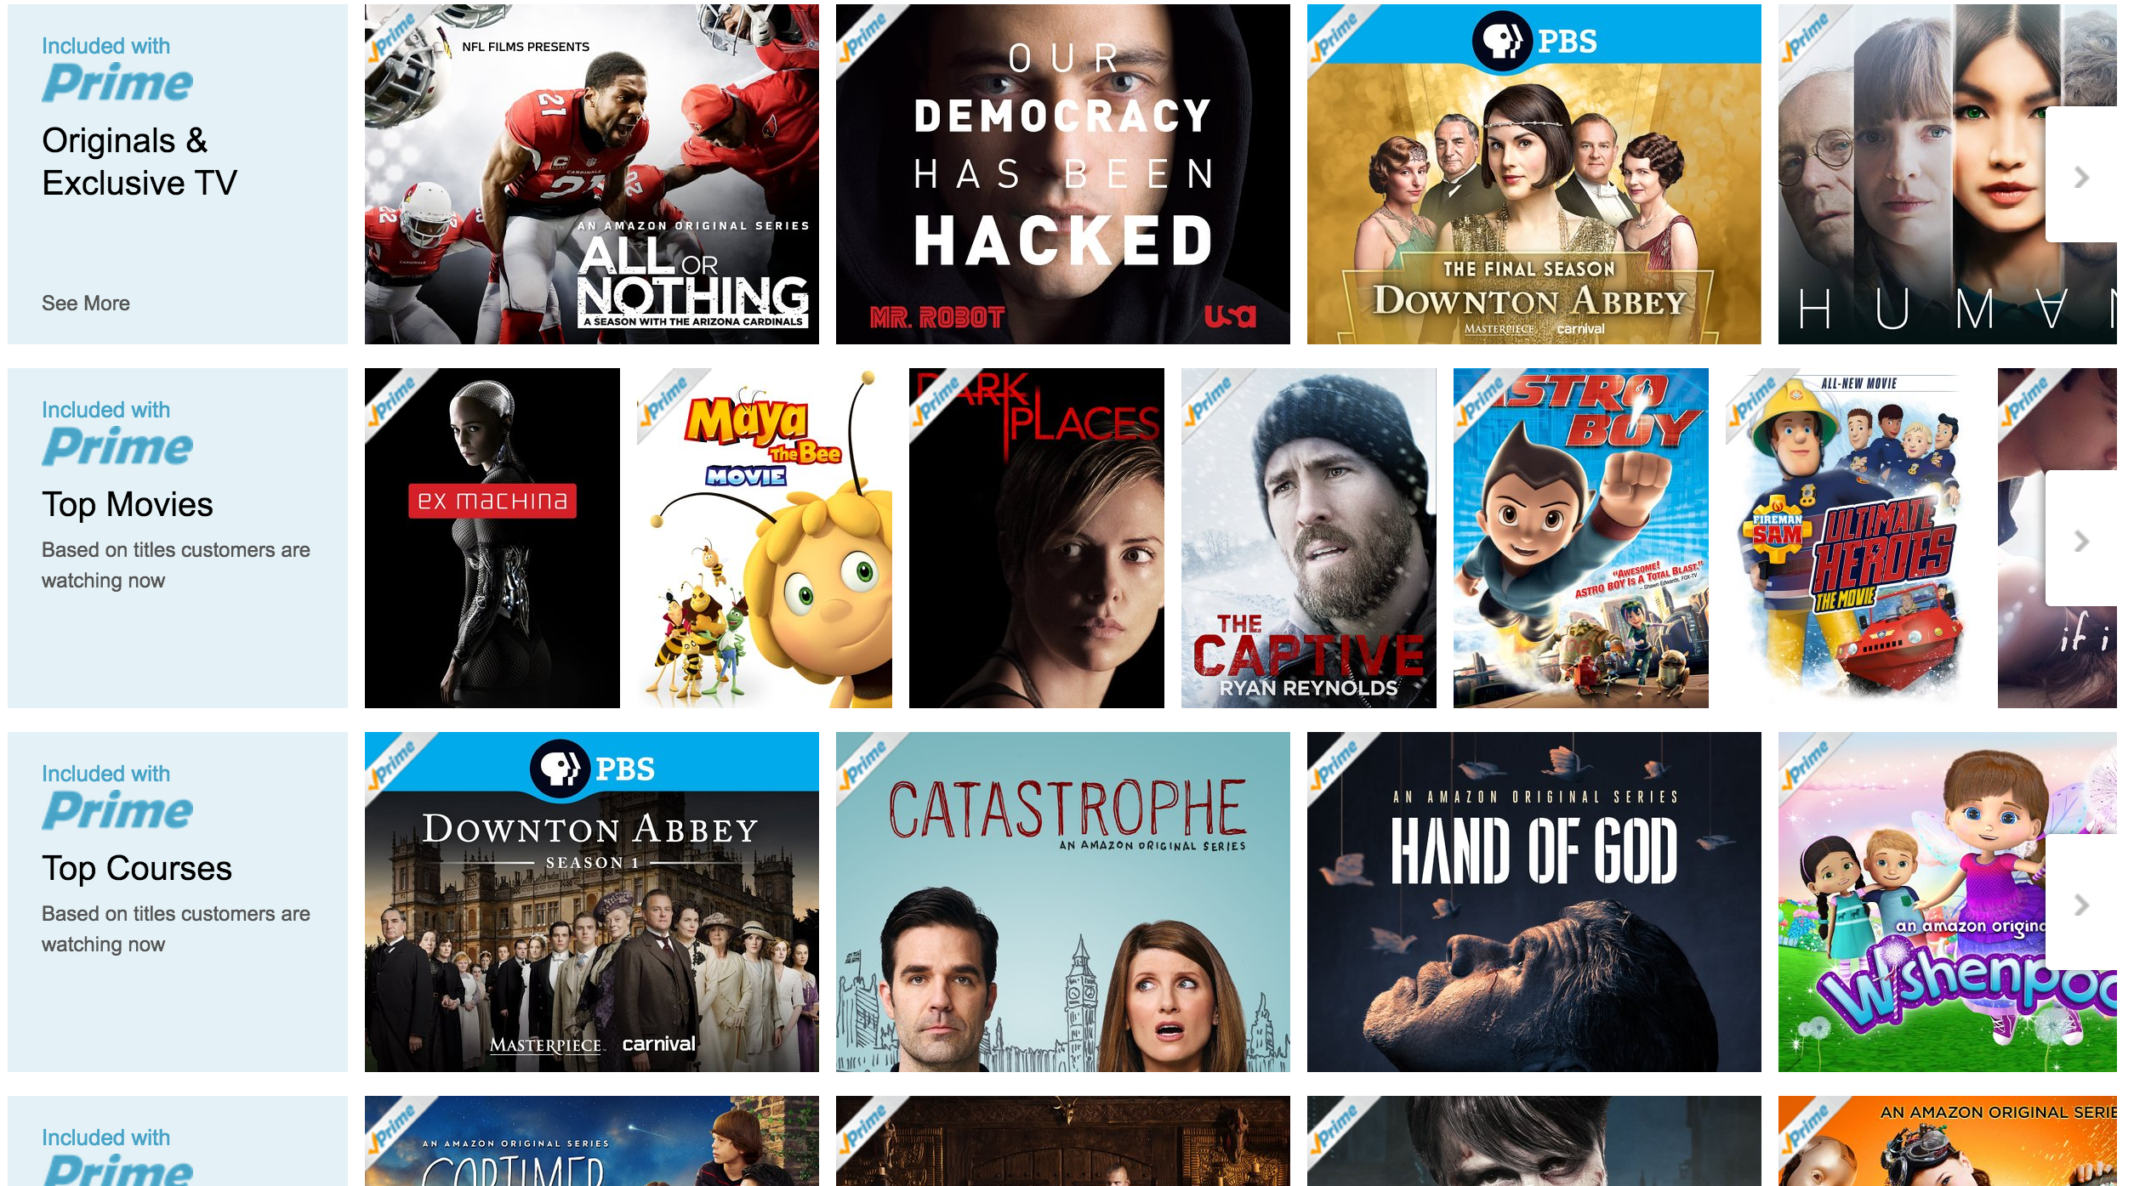





Slide 40
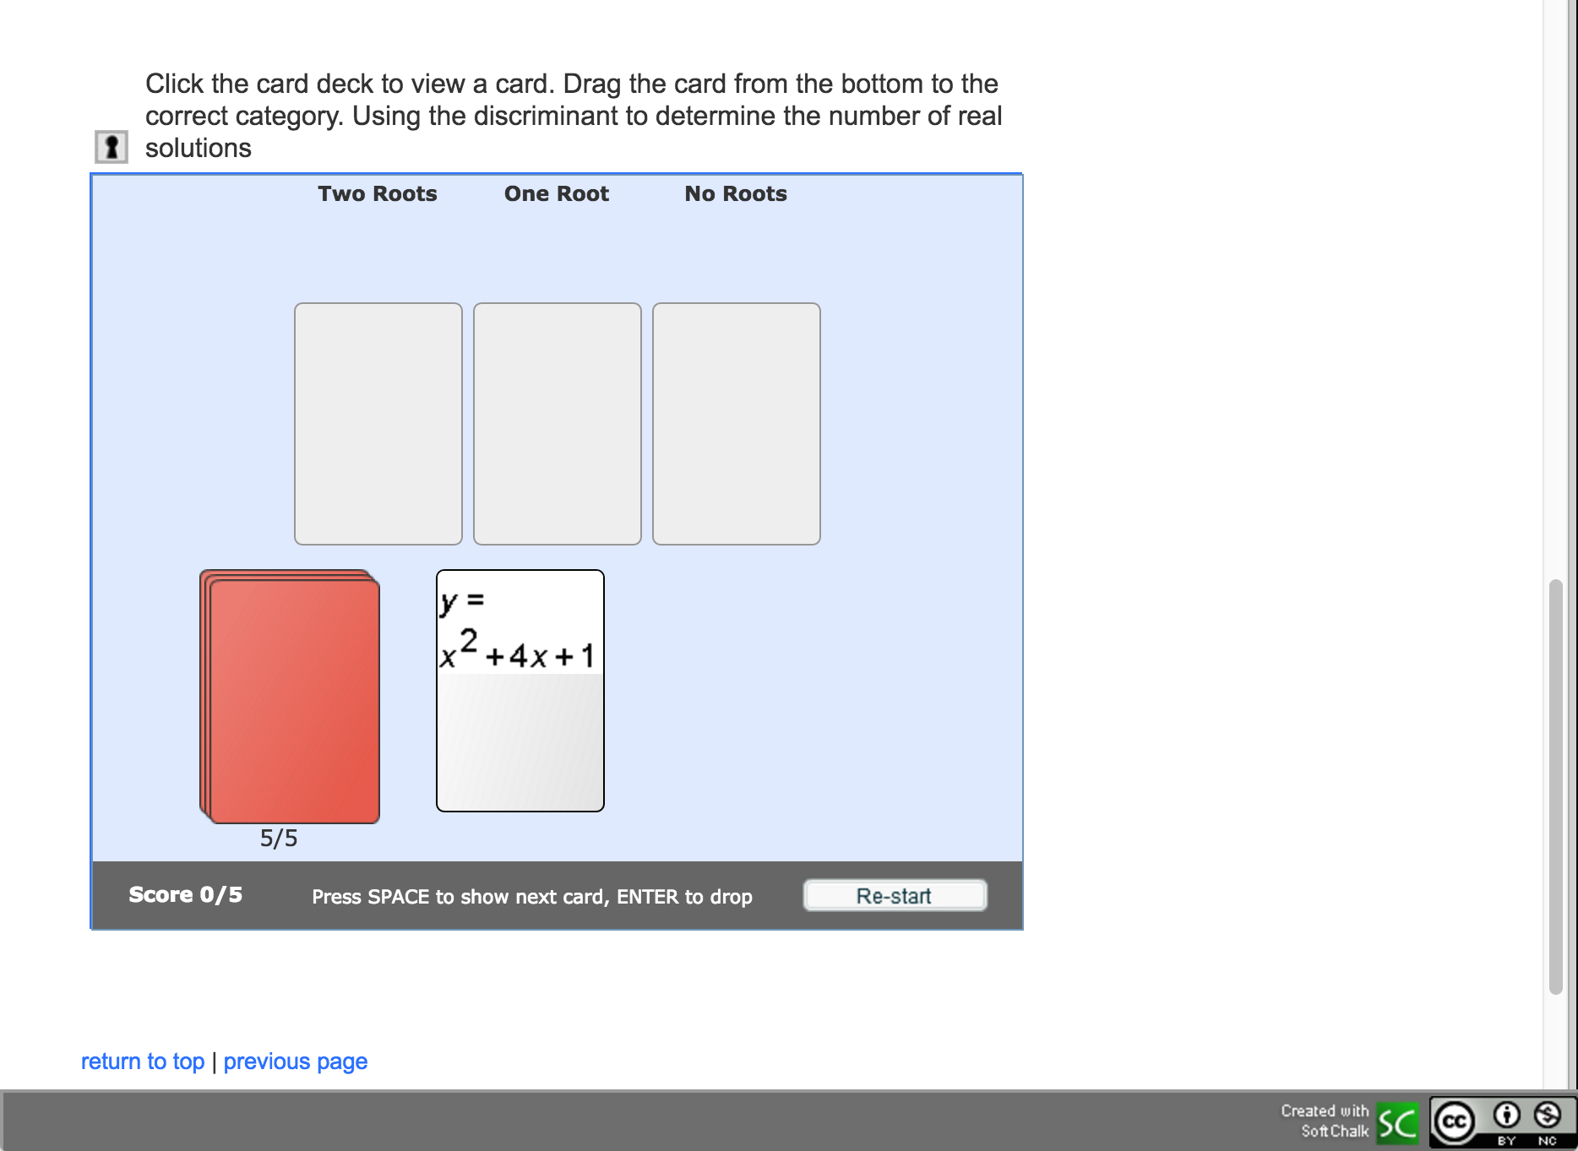
https://www.softchalkcloud.com/lesson/serve/ZKClnbpWDNG6iv/html

Slide 41
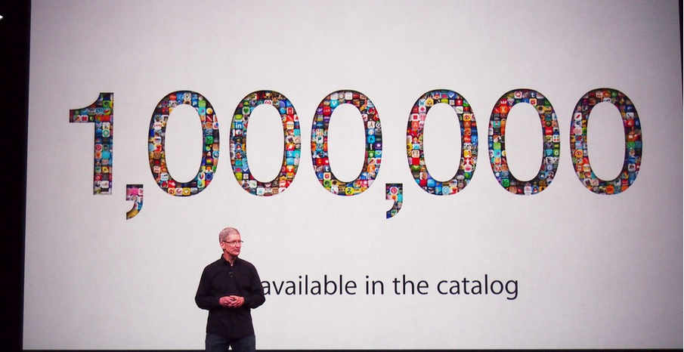
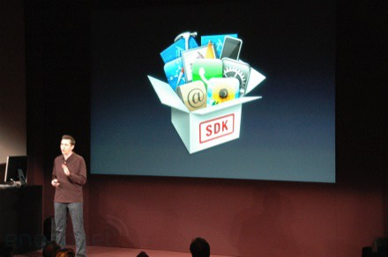
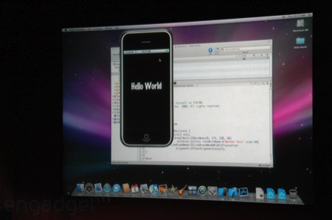
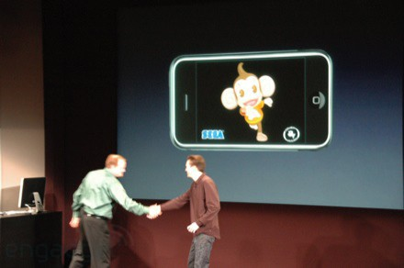
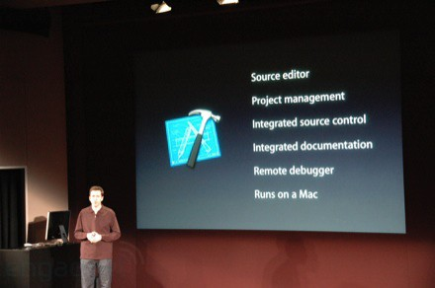
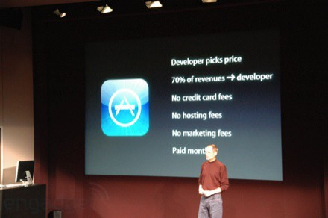
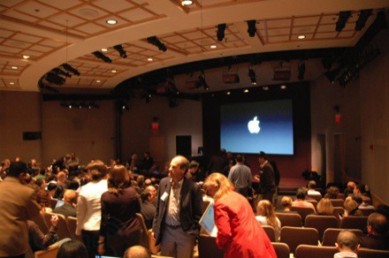
March 6, 2008 iPhone SDK Press Conference

Slide 42
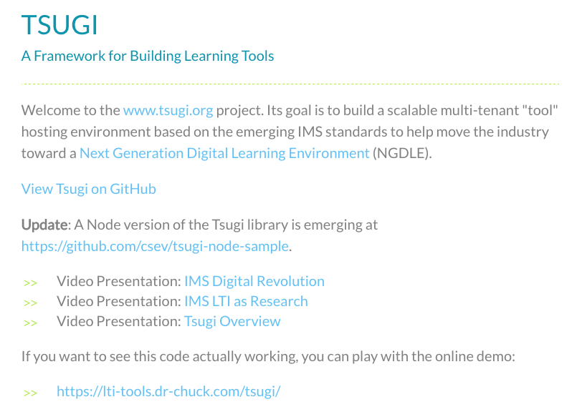
Exciting, Engaging, Interactives
www.tsugi.org

Slide 43

Traditional Education
https://commons.wikimedia.org/wiki/File:Exchange_Money_Conversion_to_Foreign_Currency.jpg

Slide 44
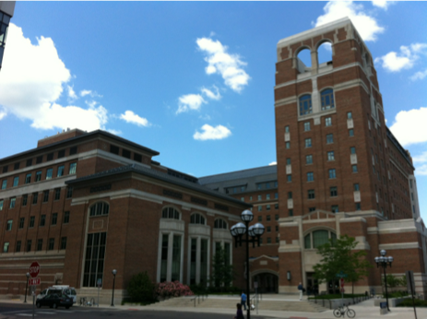
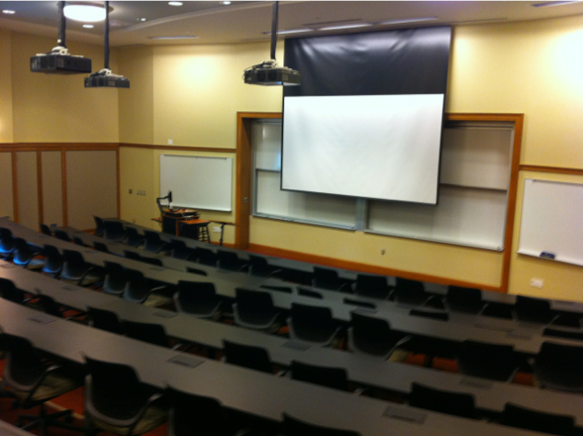
https://commons.wikimedia.org/wiki/File:Michigan_Stadium_Sept_17,2011.jpg

Slide 45
Bachelors Degree
Masers Degree
H
I
G
H
S
C
H
O
O
L
1
2
3
4
W
O
R
K
1
2
3
4
1
2
3
4
1
2

Slide 46
Bachelors Degree
Masers Degree
H
I
G
H
S
C
H
O
O
L
???
1
2
3
4
W
O
R
K
1
2
???
3
4
1
2
3
4
???
1
2

Slide 47
Bachelors Degree
Masers Degree
H
I
G
H
S
C
H
O
O
L
1
2
3
4
W
O
R
K
MOOC
MOOC
1
2
MOOC
MOOC
3
4
1
2
3
4
1
2
2
MOOC
MOOC

Slide 48
Massive
Open
Online
Courses

